Slide 1
Managing and Querying Database – Course End Project
Online Bookstore Database

Slide 2
INTRODUCTION
Online bookstores in today’s world face lots of challenging tasks such as maintaining huge volumes of books and customers details, handling many concurrent transactions, frequent updation etc.
To address these challenges, I’ve designed an online bookstore database which handles these challenging tasks efficiently by means of various aspects of MySQL such as joins, stored procedures, triggers, indexes etc.

Slide 3
FEATURES OF MY PROJECT
I’ve created multiple tables each for a particular purpose by following the rules of Normalization.
For filtering based on various conditions – where clause
Summary preparation based of any attributes – Aggregation functions
Combining different tables – Joins
Optimizing retrievals – Indexes
Handling Transactions – Transaction Control Languages(TCL)
Automating Tasks – Triggers
Creating table with selected attributes for temporary purpose - Views

Slide 4
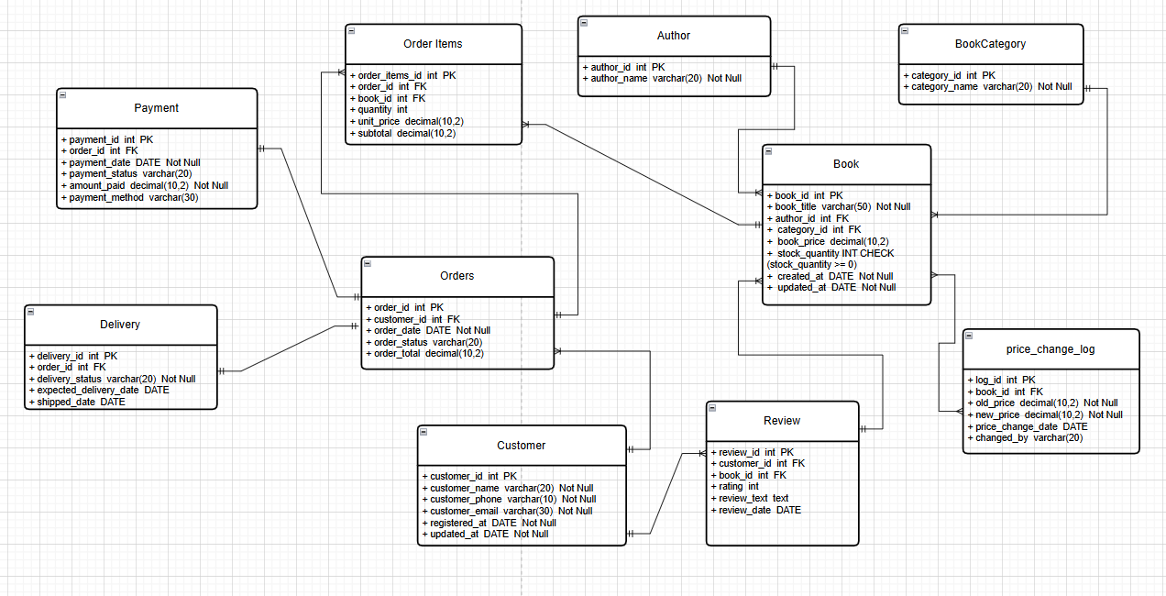
ER DIAGRAM

Slide 5
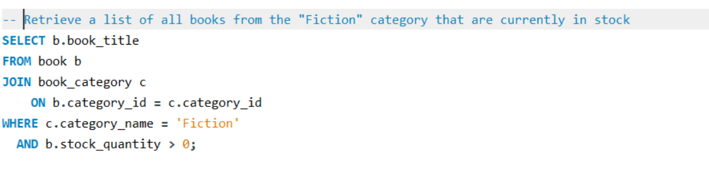
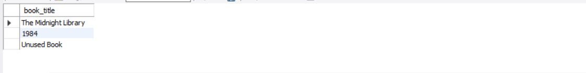
Sample Query And Output

Slide 6
ABOUT VARIOUS ASPECTS OF MYSQL
1) Normalization
* What it is: Organizing data into separate tables to reduce redundancy and improve data consistency.
* In my project: Author, Book, Category, Customer, and Orders are stored in separate tables to avoid duplicate data.
2) Primary Key:
* What it is: Uniquely identify each record in a table.
* In my project: In my project author_id is primary key for author table, book_id is primary key for book table etc.

Slide 7
3) Foreign Key
* What it is: A column that creates a relationship between two tables by referencing a primary key.
In my project: book.author_id links the Book table to the Author table.
4) Joins
* What it is: Used to combine data from multiple tables based on related columns.
* In my project: JOIN is used to fetch book details, customer info, and order data together in reports.
5) Subqueries
* What it is: A query inside another query to filter or calculate results.
* In my project: Subqueries are used to find customers who spent more than ₹10,000 or books never purchased.

Slide 8
6) Stored Procedures
* What it is: A reusable set of SQL statements that performs a specific task.
* In my project: Procedures are used to prevent orders when previous payments are pending for more than 30 days.
7) Locks
* What it is: Mechanism to control concurrent access to data and avoid conflicts.
* In my project: SELECT … FOR UPDATE is used to prevent multiple customers from buying the same book simultaneously.
8) Triggers
* What it is: Automatic actions executed when a specific database event occurs.
* In my project: Triggers automatically update book stock and log price changes when data is modified.

Slide 9
TAKEAWAYS
Designed an online bookstore database by identifying necessary entities, their attributes and relationship between them.
Created the required tables by using Data Definition Language(DDL),manipulated data using Data Manipulation Language(DML) and retrieved using Data Query Language (DQL)
Written efficient queries to solve the asked question by using various aspects of MySQL such as Joins,Subqueries,Triggers,Procedures,Exception handling etc.

Slide 10
THANK YOU!

